Slide 1
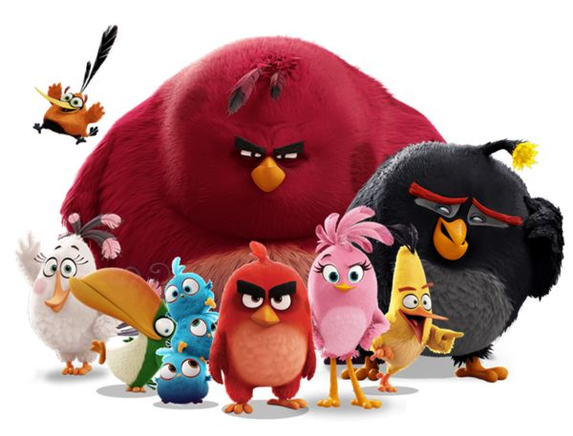
ALGORITHM
WELCOME

Slide 2

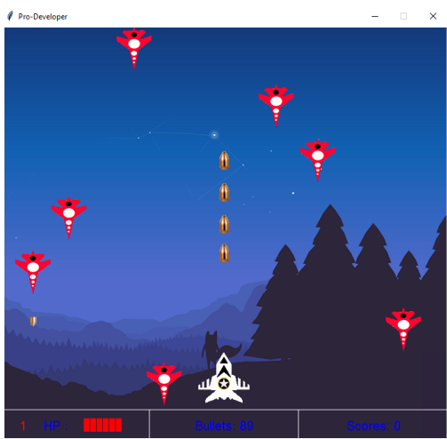


TERM 2
MOD WEP
11 WEEKS
11 WEEKS
MAY
JUN
JUL
AUG
SEP
OCT
ALGO-1 - 66 H
6 H / WEEK – 11 W
ALGO-2 - 72 H
12H / WEEK – 6 W
Boolean
String
Indexes
Errors
Hackathon
Create
video game
loops
condition
Variables
Arrays
dictionary
functions

Slide 3



DON’T ASK
ANSWER
TO YOUR FRIENDS
THINK ON
PAPER
FIRST
WORK
HARD
FIND BY YOURSELF
DON’T GIVE UP

Slide 4


EVALUATION
QUIZES 30 %
EXAMS
MIDTERM 20 %
FINAL 40 %
PARTICIPATION 10 %
1 QUIZ every 2 weeks

Slide 5
What is
an algorithm ?

Slide 6
An algorithm is a list of steps to accomplish an objective
Objective
Steps
Go to PNC
Wake up
Take shower
Take bike
Say good morniiiing

Slide 7


where will be the robot at the end of the program ?
GO RIGHT
A
B
C
D
E
GO RIGHT
1
GO DOWN
2
3
4

Slide 8
It is Monday, where will be the robot at the end of the program ?
GO RIGHT
A
B
C
D
E
GO RIGHT
1
2
Day = TUESDAY
FALSE
TRUE
3
4
GO DOWN
GO DOWN

Slide 9

How many diamonds left at the end of program ?
GO RIGHT
PICK UP
GO RIGHT
GO UP
GO UP
PICK UP

Slide 10
CHALLENGE
MAX BLOC
BLOCS
#1
11
GO RIGHT
PICK UP
Robot must pick up all diamonds

Slide 11
CHALLENGE
MAX BLOC
BLOCS
#2
11
GO RIGHT
PICK UP
GO UP
Robot must pick up all diamonds

Slide 12
What is
a loop ?

Slide 13
A loop
A loop is type of instruction
A loop contains a list of instructions that repeat until a specified condition is reached

Slide 14
Each execution of the loop is an iteration
GO UP
GO RIGHT
GO UP
GO RIGHT
GO UP
GO RIGHT
GO UP
GO RIGHT
REPEAT 4
GO UP
GO RIGHT
=
iteration4
iteration3
iteration2
iteration1

Slide 15
A loop can contain other loops
REPEAT 3
CLAP YOUR HANDS
SAY “BANANA”
What does this program
do ?
REPEAT 2
JUMP

Slide 16
A loop can contain other loops
CLAP YOUR HANDS
SAY “BANANA”
JUMP
JUMP
CLAP YOUR HANDS
SAY “BANANA”
JUMP
JUMP
CLAP YOUR HANDS
SAY “BANANA”
JUMP
JUMP
REPEAT 3
CLAP YOUR HANDS
SAY “BANANA”
=
REPEAT 2
JUMP

Slide 17
CHALLENGE
MAX BLOC
BLOCS
#3
10
GO RIGHT
PICK UP
REPEAT< N time >
GO UP
Repeat<5>
Go Right
PICK UP
GO UP
GO UP
Repeat<5>
Go Right
PICK UP

Slide 18
CHALLENGE
MAX BLOC
BLOCS
Go right
#4
10
Repeat<5>
GO RIGHT
PICK UP
REPEAT< N time >
Go right
GO UP
Pick up
Repeat<6>
Go right
Pick up

Slide 19
CHALLENGE
MAX BLOC
BLOCS
Repeat<3>
#5
06
Repeat<2>
GO RIGHT
PICK UP
REPEAT< N time >
GO RIGHT
GO UP
Repeat<3>
PICK UP
GO RIGHT

Slide 20

CHALLENGE
MAX BLOC
BLOCS
#6
08
GO RIGHT
PICK UP
REPEAT< N time >
GO UP
GO DOWN
GO RIGHT
Repeat<4>
GO DOWN
PICK UP
Repeat<4>
GO UP
GO RIGHT
PICK UP

Slide 21
CHALLENGE
MAX BLOC
BLOCS
GO RIGHT
PICK UP
REPEAT< N time >
#6
10
GO UP
GO DOWN
GO RIGHT
GO RIGHT
Repeat <4>
Repeat <5>
GO UP
Repeat <2>
GO RIGHT
Repeat <5>
GO DOWN
PICK UP

Slide 22
CHALLENGE
MAX BLOC
BLOCS
#7
10
GO RIGHT
PICK UP
REPEAT< N time >
GO UP
Repeat <2>
GO DOWN
GO DOWN
PICK UP
Repeat <5>
GO RIGHT
PICK UP
GO UP
PICK UP

Slide 23
CHALLENGE
MAX BLOC
BLOCS
#8
10
GO RIGHT
PICK UP
REPEAT< N time >
GO UP
DROP
Repeat <4>
GO DOWN
Repeat <5>
DROP ALL DIAMONDS TO THE GREEN CELLS
GO RIGHT
Repeat <4>
GO DOWN
PICK UP
Repeat <5>
GO LEFT
DROP

Slide 24
CHALLENGE
MAX BLOC
BLOCS
#9
10
GO RIGHT
PICK UP
REPEAT< N time >
GO UP
GO RIGHT
GO DOWN
GO UP
Repeat <2>
Repeat <2>
GO RIGHT
Repeat <2>
GO DOWN
PICK UP
Repeat<2>
Repeat<3>
GO UP
Repeat<2>
GO RIGHT
Repeat<2>
GO DOWN
PICK UP

Slide 25


HOMEWORK
INDIV
After class
1. Review this lesson.
2. Finish all challenges
3. Submit your work to Google Classroom

